Slide 1
Unit 3: Presentation
Made by: Joseph Roper, Cameron Whittle, James Diep

Slide 2
Introduction
In this assignment we researched people's opinions on top down perspective action games, the reason why we wanted to know this is so we can have the information on how to create our game and whether or not we should make any changes to our original idea.
From our research we concluded that our game (Terropiia) will be an open world top down action RPG with pixel art graphics. The story will take place in the world of Terropiia, a war torn world between the humans and the Demon Lord’s Army.

Slide 3
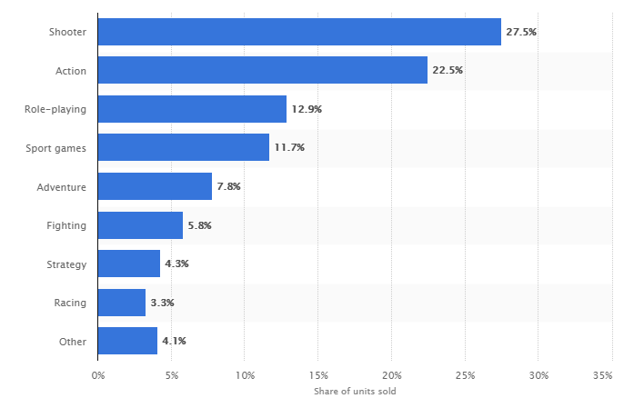
Secondary Research
Our first research method was to check the results of other people's research on different game genre's and how popular they are.
We found this graph useful as it shows us the best selling and most popular genre of games. We can use this information to create a game that we believe will sell well and become very popular within the community.
https://www.statista.com/statistics/189592/breakdown-of-us-video-game-sales-2009-by-genre/

Slide 4
Research methods
Our second research involved us creating an online survey on the website SurveyMonkey.com which we handed out around our college and gave the link to people we know who fit our target market so they could also fill out the survey.
Our final piece of research we did was our focus group where we had people who fit our target market play a game which we want to base ours off of and then at the end of their play time we asked them questions about what they liked about it and if they would change the game.

Slide 5
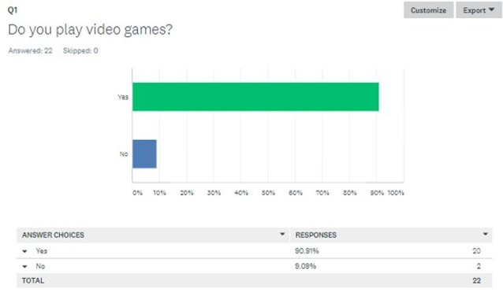
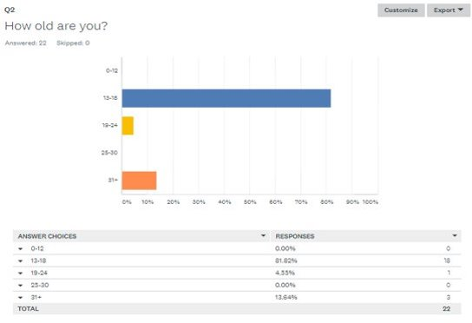
Research Method 1 -SurveyMonkey

Slide 6
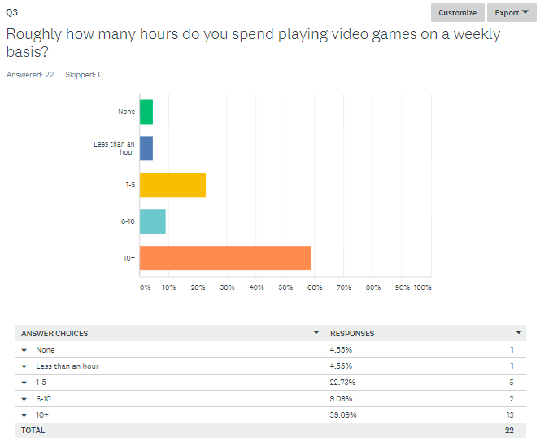
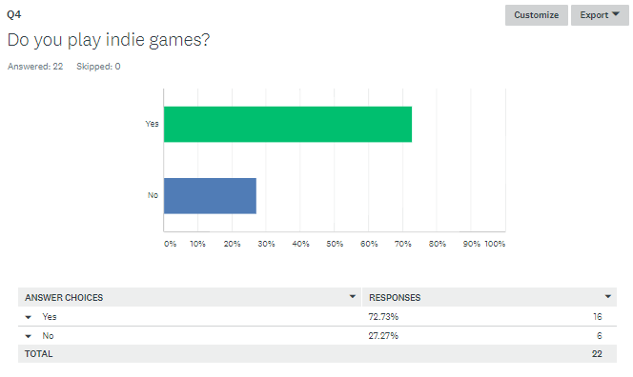

Slide 7
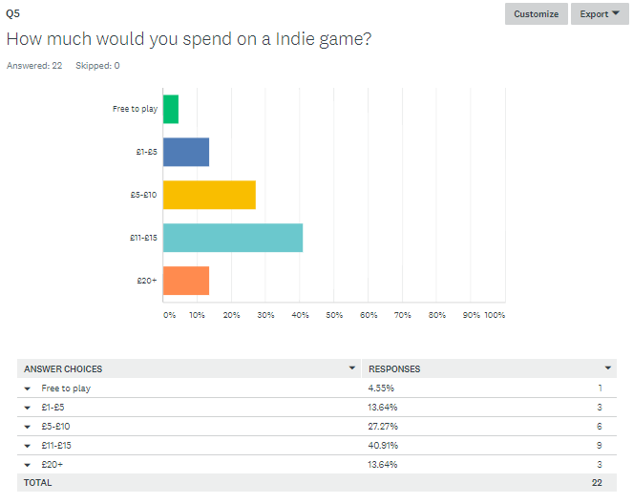
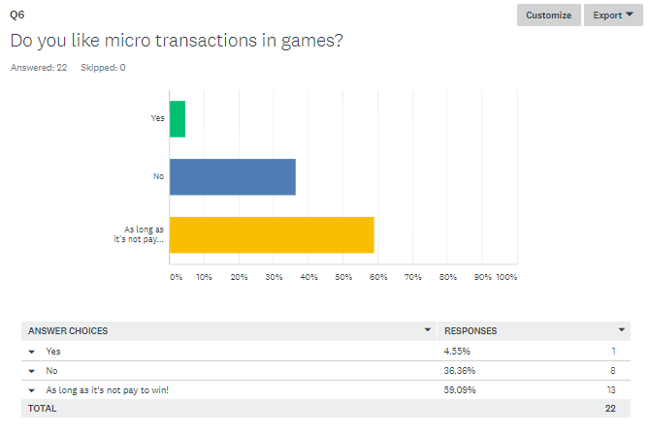

Slide 8
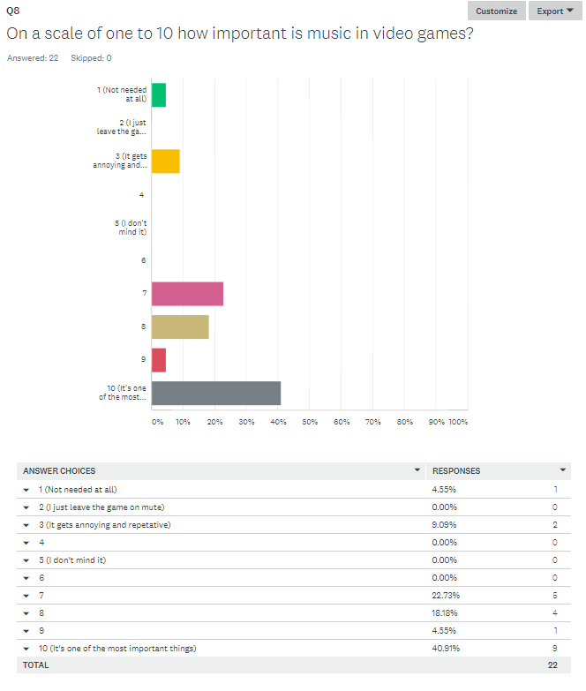
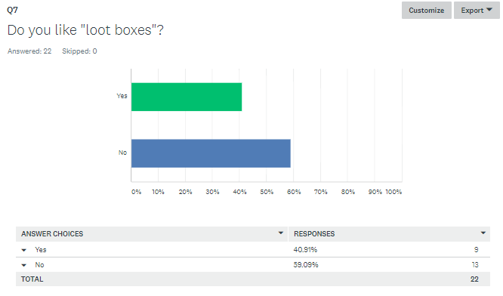

Slide 9
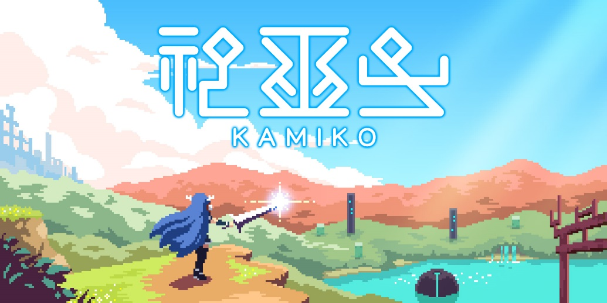
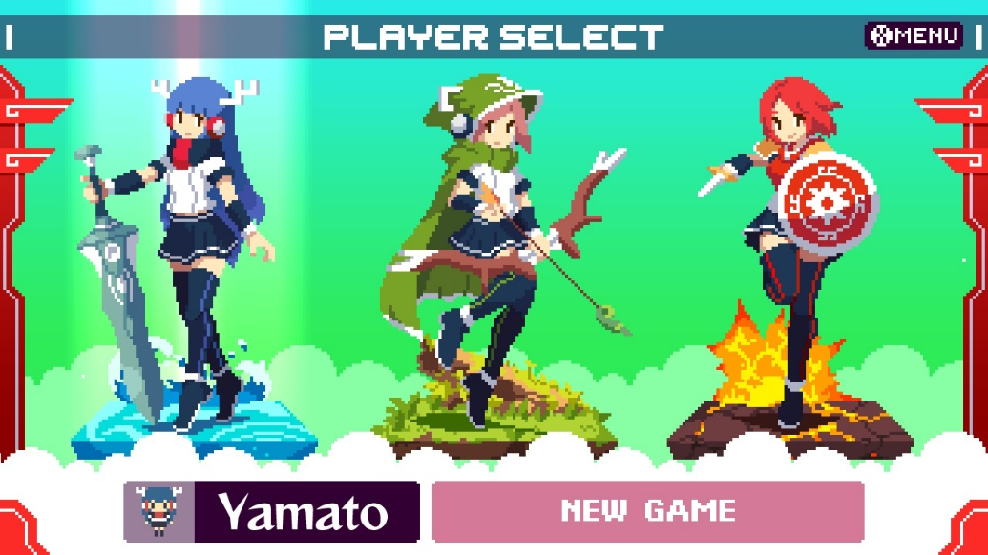
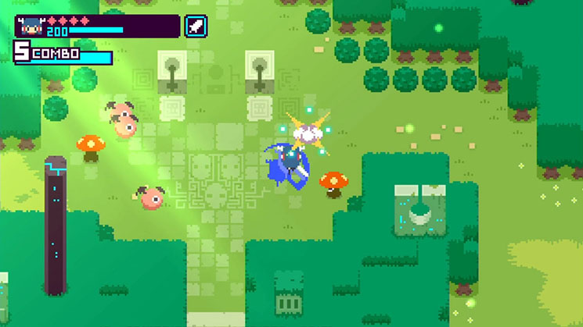
Audience Research
For our Audience research we decided to hold a focus group for the game "Kamiko" which is similar to the idea we have for our game. We asked 5 people on what they thought about the game Kamiko after playing the first level.
Did you like the game? Outstanding yes.
If you could make any changes to the game, what would they be? More weapons/classes (which we already had in our plan), they also wanted more variety between enemies
Do you think Kamiko should have more story? Yes, they liked the lore in the story
Did you like the combat system in Kamiko? Yes but it got repetitive, so they wanted more combos.
Did you like the art direction in Kamiko? Yes, it is very retro.
Do you think the puzzles in Kamiko were challenging enough? No, they found it pretty easy
What did you think about the music in Kamiko? They liked the music.
Do you think Kamiko is worth it at its price of £5? Yes, they thought they would buy at a higher price.

Slide 10
Production Research
For our second research method we handed out QR codes linking to our questionnaire on survey monkey. We were able to get 22 people to take part in our survey through this method, giving us valuable information when thinking of how we want to make our game.
The research took place at our college in one of our classes as we thought everyone in our class was part of our target market is teenagers to young adults who like video games. For our focus group we needed a Nintendo Switch with the game Kamiko.

